Slide 1

Bus guide and location reminder system (Muthopath)
Project Co-Supervisor
Debbrata Kumar Saha
Lecturer
Computer Science & Engineering
State University of Bangladesh
Project Members
1. Arefin Newaz Prince
ID: UG02-29-12-035
2. Hemendra Rupak Biswas
ID: UG02-29-12-026
3. Rashedul Karim
ID: UG02-29-12-030
Project Supervisor
Dr. Bilkis Jamal Ferdosi
Head of the Department
Computer Science & Engineering
State University of Bangladesh

Slide 2
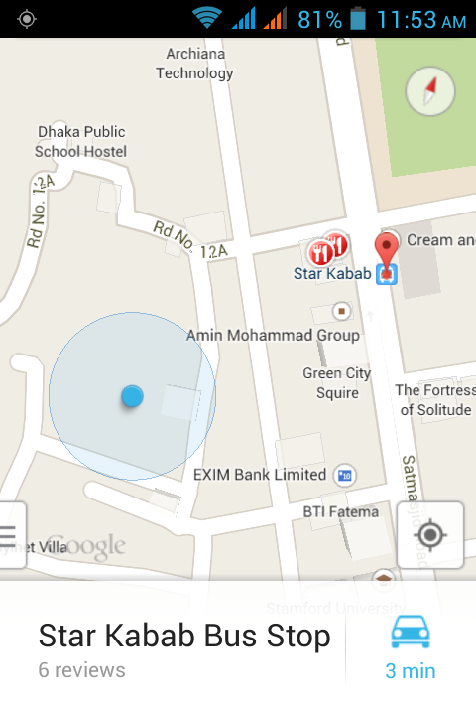
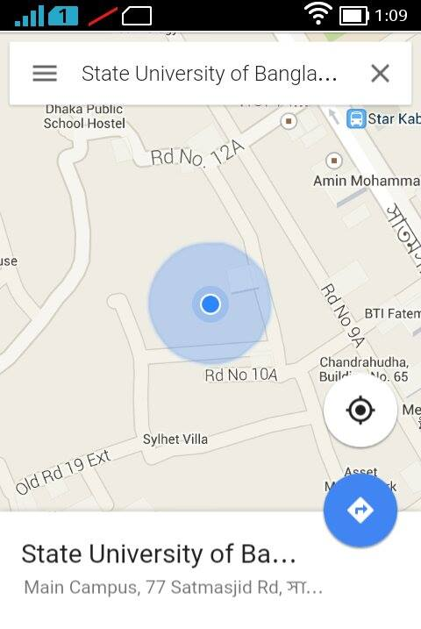
introduction
This is an android application that uses the Google Maps Android API v2.

Slide 3
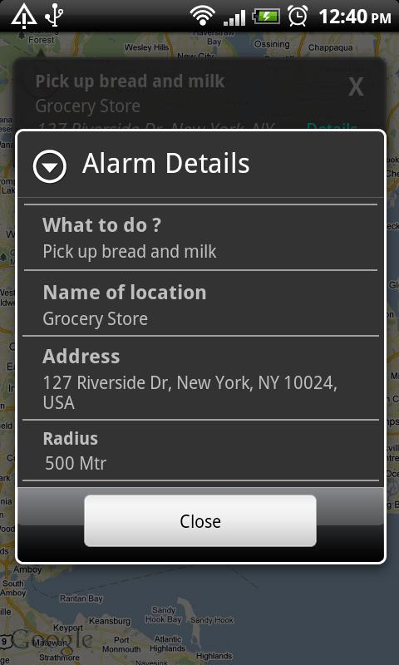
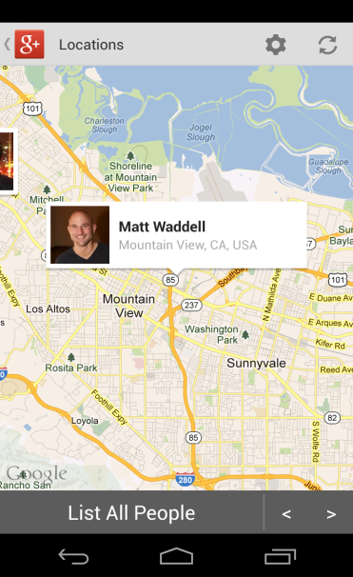
Project Overview
Tracking User’s own location and nearby bus stops.
Easier to select bus where he/she has to go and can calculate the distance.
User can observe real time movement.
Notified the user when he/she reach the nearest/desired scheduled destination.
Can detect nearest paired device.

Slide 4
System Flowchart
Bus Info Entry
Bus info
Bus Info
Bus List
report
Bus stops entry
Stops info
Stops Info
Stops List
report
User location
User loc info
Location Info
Location List
report
Schedule Entry
Schedule info
Schedule Info
Schedule List
report
Google Map

Slide 5
Database Sample
schedule
uid | subject | locX | locY
1 | Buy a Mouse | 23.77853 | 90.379166
2 | Meet Friends | 23.751696 | 90.367365

Slide 6
busstops
uid | busstops_id | bs_name | locX | locY
1 | bs_1 | Mohammadpur | 23.765845 | 90.358338
2 | bs_2 | Shankar | 23.751696 | 90.367365
3 | bs_3 | Jighatala | 23.737547 | 90.376392
4 | bs_4 | Shahbagh | 23.723398 | 90.385419
5 | bs_5 | Motijhil | 23.709249 | 90.394446

Slide 7
busses
uid | busstops_id | b_name
1 | bs_1 | Citybus
2 | bs_2 | Citybus
3 | bs_3 | Citybus
4 | bs_4 | Citybus
5 | bs_5 | Citybus
6 | bs_1 | Nishargha
7 | bs_2 | Nishargha
8 | bs_3 | Nishargha

Slide 8
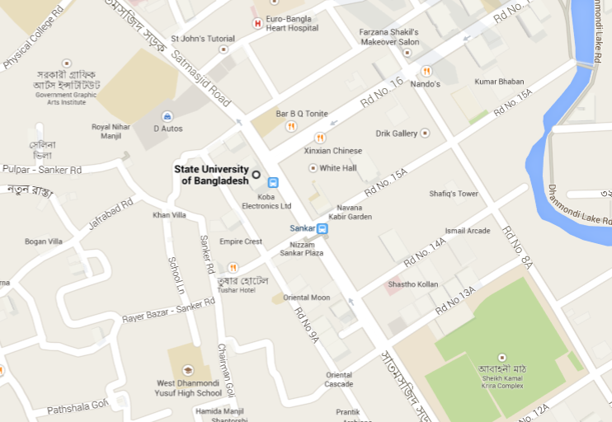
Map View

Slide 9
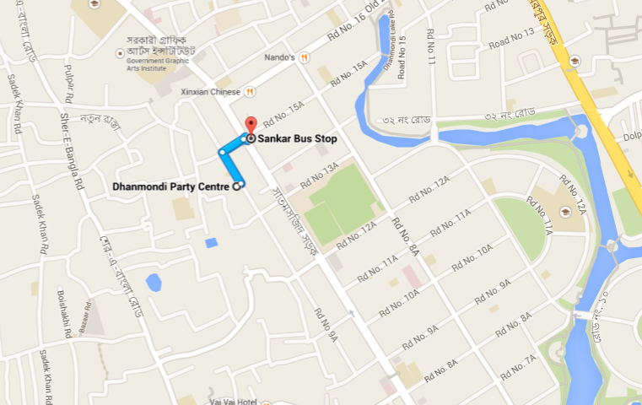

Slide 10
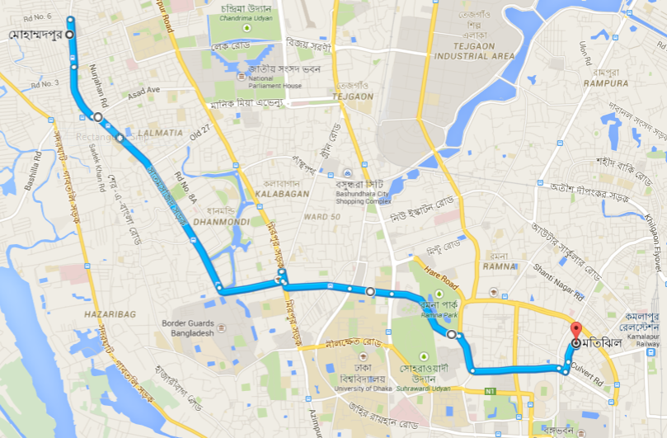

Slide 11
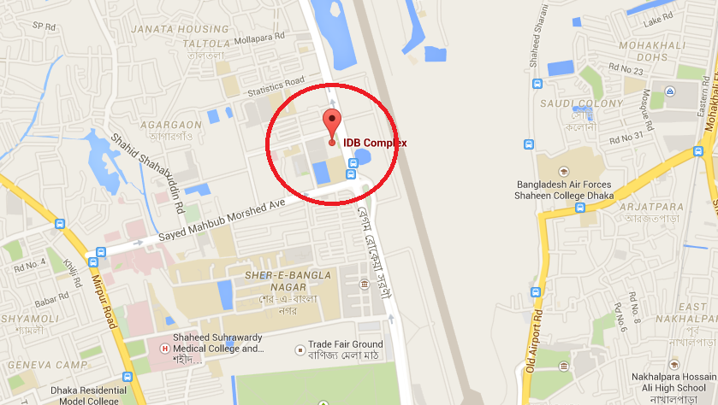

Slide 12
Thank You

